Slide 1

Mohanlal Sukhadia University

Slide 2

LET’S BEGIN..

Slide 3
IEEE -:
Institute of Electrical and Electronics Engineers
1884 : the American Institute of Electrical Engineers (AIEE) was
founded.
On January 1,1963 the IEEE was born with 1,50.000 members
IEEE is an abbreviation for Institute of Electrical and Electronics Engineers.
IEEE Society has more than 4 lakh+ members working in wide range of
industries.
Computer Society of IEEE alone has more than 1 lakh members .
IEEE-SA is not a body formally authorized by any government, but rather a
community.

Slide 4
IEEE 802 STANDARDS -:
The number 802 is associated with the date of the first meeting that was held in the year of - February,1980.
A family of IEEE standards deals in LAN, MAN and WAN.
IEEE had over 1100 active standards with over 600 standards under development.
IEEE 802 standards are restricted to networks carrying variable-size packets.
IEEE 802 map to the lower two layers (Data Link and Physical layer) of the seven-layer OSI networking reference model.

Slide 5
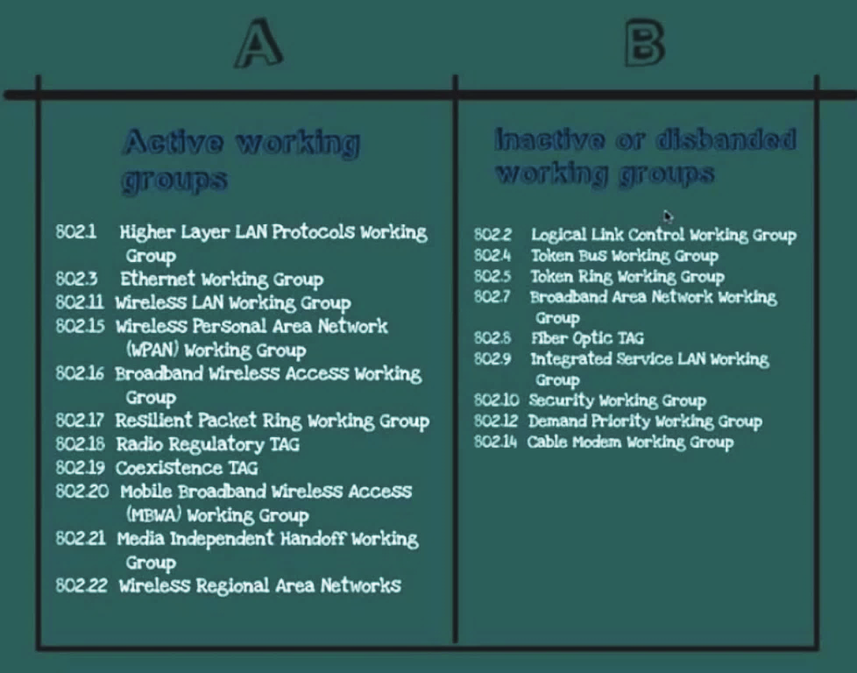
IEEE 802 STANDARDS
Active | PURPOSE
802.1 | Bridging and management
802.2 | Logical link control
802.3 | Ethernet LAN
802.5 | Token ring LAN
802.7,8,9,10 | Broadband LAN, Isochronous LAN, Network security
802.11 | Wireless network
802.15 | Wireless PAN
802.16,17,18 | Wireless MAN
802.20,21,22,23 | Broadband wireless access

Slide 6
802.1 ( Bridging ) -:
Overall picture of LAN and connectivity .
Addressing Network Management .
Standards for bridges .
IEEE 802.1 is a working group of the IEEE 802 project of the
IEEE Standards Association
It is concerned with:
802 LAN/MAN architecture
internetworking among 802 LANs, MANs and wide area networks
802 Link Security
802 overall network management
protocol layers above the MAC & LLC layers

Slide 7
802.2 ( LLC ) -:
Logical Link Control .
Communication of packets from one device to another device.
Deals with communication.
LLC is a software component that provides a uniform interface to the
user of the data link service, usually the network layer.
LLC may offer three types of services:
Unacknowledged connectionless mode services (mandatory)
Connection mode services (optional)
Acknowledged connectionless mode services (optional)

Slide 8
802.3 ( Ethernet ) -:
An IEEE standard that defines the MAC layer for bus networks that use
CSMA/CD. This is the basis for the Ethernet Standard.
Ethernet is a type of cabling and signaling specifications.
A connection based topology because workstations are in competition for
channel bandwidth.
Organized around the concept of layered protocols.
Advantages:
Inexpensive way to get high speed up to 100 Mbps.
Supports various wiring technologies.
Easy to install.

Slide 9
CSMA/CD -:
The best known scheme for controlling a local area network on a bus structure is carrier sense multiple access with collision detection.
The major functions:
Data encapsulation/ decapsulation 3) Data encoding/ decoding
Media access management 4) Channel access
Transmit
User layer
Receive
Data encapsulation
Data decapsulation
DDL/MAC sublayer
Media access management
Media access management
Data encoding
Data decoding
Physical Layer
Channel access
Channel access
Channel

Slide 10
802.5 ( Token Ring ) -:
Token Ring unlike ethernet, requires active interface.
Speed of 4mbps or 16 mbps.
Set of nodes connected in a ring topology .
Data always flow in a particular direction around the ring.
Each node in the ring receiving the packet from its upstream neighbour and then
forwarding them to its down stream neighbour .
Token - is use to access the different nodes of ring.
Each node receives and forward the token.
The token ring network is designed in such a way that each node on the network
is guaranteed access to the token at some point .
Notes:
diagram

Slide 11

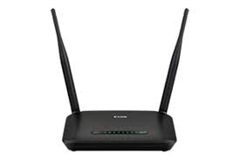

802.11 ( wlan ) -:
Wireless Local Area Network.
Provides network connectivity over wireless media.
An access point (AP) is installed to act as bridge between wireless and wired
network.
The AP is connected to wired network and is equipped with antennae to provide
wireless connectivity.
Network connectivity
to the legacy wired LAN
Desktop
Access
point
Laptop

Slide 12
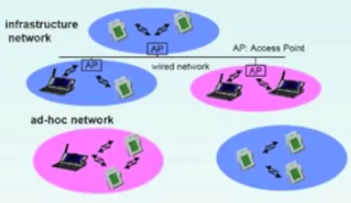
Types of 802.11
Infrastructure based
Ad-hoc based
ADVANTAGES :
Flexible development.
Reduces bottlenecks.
More robust against disasters.
DISADVANTAGES :
Low bandwidth composed to wired networks (1-10 Mbits).
Needs to follow wireless spectrum regulations.
Notes:
Types-pictures draw

Slide 13
802.11 802.11a 802.11b 802.11g 802.11n
Standard | Release date | Theoretical max speed | Typical real-world top speed
802.11a | 1999 | 54Mbps | approx. 25 Mbps
802.11b | 1999 | 11Mbps | approx. 6.5 Mbps
802.11g | 2003 | 54 Mbps | approx. 25 Mbps
802.11n | 2007 | 600 Mbps | approx. 200Mbps
Notes:
Best out of all

Slide 14
802.15 ( WPAN ) -:
Wireless Personal Area Networks
WPAN standard based on Bluetooth (802.15-1).
In addition standards have been published for co-existance of PANS
and WLANS (802.15-2).
The 802.15-3 provides 20 mbps of data rate .
802.15-4 i.e. “Zigbee” provides 250 kbps of data rate.

Slide 15
802.15
802.15.1
802.15.2
802.15.3
802.15.4
802.15.3.a
802.15.3.b
802.15.4.a
802.15.4
WPAN group
(high rate)
Zigbee
Bluetooth
Revisions and enhancements
Coexistence
group
MAC amendment
task group
WPAN multimedia
task
WPAN
low rate
alternative

Slide 16
Bibliography -:
Computer networks- Andrew S. Tanenbaum
Wikipedia
m.ieee.org
ieeeusa.org

Slide 17
THANK YOU

